Slide 1
Nourriture - Connect People with Ingredients
fastDev@CI_Jenkins
Beijing Jiao Tong University

Slide 2
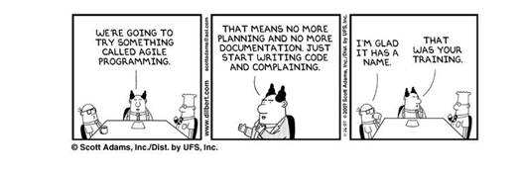
Have a Fun
Beijing Jiao Tong University

Slide 3
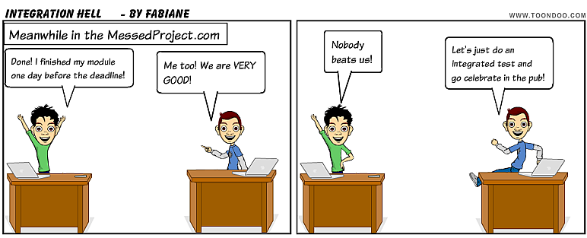
What CI
In software engineering Continuous integration (CI) is the practice of merging all developer working copies with a shared mainline several times a day.
The main aim of CI is to prevent integration problems that "integration hell".
Beijing Jiao Tong University

Slide 4
What Integration Hell
In the Real World
-- 6 developers
-- 905 files / ~56,000 LOC
-- 942 commits
-- 200+ deployment
A deployment every 43 Mins
Beijing Jiao Tong University

Slide 5
What Deployment
New code added
Requirements / Dependencies installed
Database schema updated
Fixtures (data) loaded
Tests passed (Integration Test, Unit Test, etc)
Reports Generated (Test coverage, Static Check, etc)
Documentation generated
Services restarted
Beijing Jiao Tong University

Slide 6

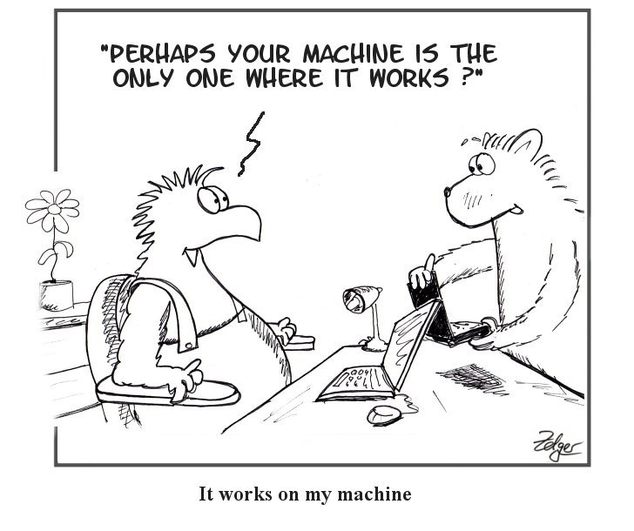
Why Integration Hell
git push origin master
Beijing Jiao Tong University

Slide 7

GIT Flow
The main branches
-- master
-- develop
The supporting branches
-- Feature branches
-- Release branches
-- Hotfix branches
The detail, please refer to here
Beijing Jiao Tong University

Slide 8
Best Practice of CI
Automate the build
Make the build self-testing
Everyone commits to the baseline every day
Every commits (to baseline) should be built
Keep the build fast
Test in a clone of the production environment
Make it easy to get the latest deliverables
Everyone can see the results of the latest build
Automate deployment
Beijing Jiao Tong University

Slide 9
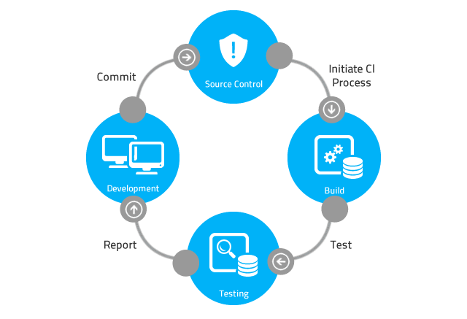
Spot Problems Early
Beijing Jiao Tong University

Slide 10
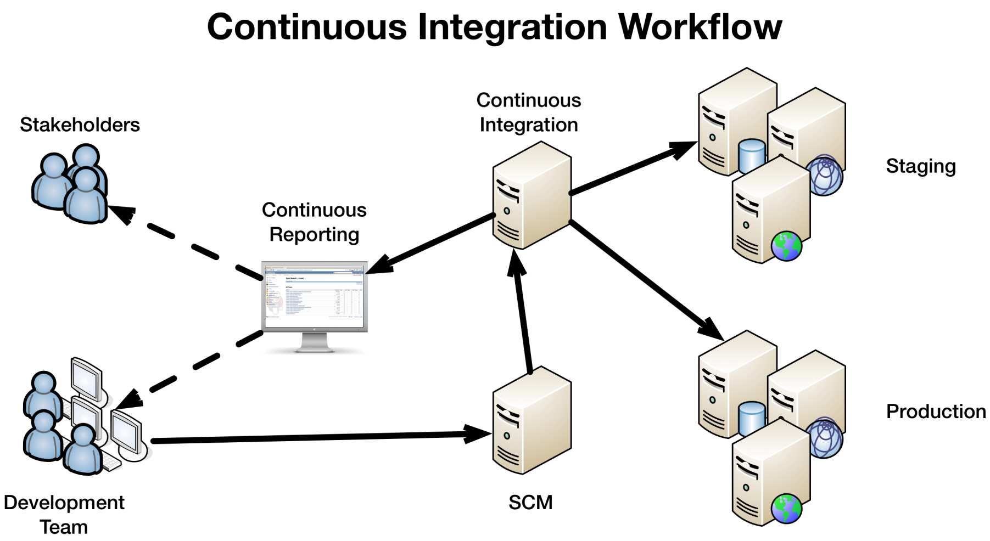
Infrastructure of CI Workflow
Beijing Jiao Tong University

Slide 11
CI Application - Jenkins
Jenkins is an open source Continuous Integration tool written in Java. The project was forked from Hudson after a dispute with Oracle.
Jenkins provides continuous integration services for software development. It is a server-based system running in a servlet container such as Apache Tomcat.
It supports SCM tools such as Git and execute Ant project, Maven project as well as arbitrary shell scripts and Windows batch scripts.
Beijing Jiao Tong University

Slide 12
Types of Jobs
Building/testing software projects continuously
-- In a nutshell, Jenkins provides an easy-to-use so-called continuous integration system, making it easier for developers to integrate changes to the project, and making it easier for users to obtain a fresh build. The automated, continuous build increases the productivity.
Monitoring executions of externally-run jobs
-- For example, with cron (a time-based job scheduler), all you receive is regular e-mails that capture the output, and it is up to you to look at them diligently and notice when it broke. Jenkins keeps those outputs and makes it easy for you to notice when something is wrong.
Beijing Jiao Tong University

Slide 13
Jenkins tutorials
-- Requirements
Beijing Jiao Tong University

Slide 14
App Structure
Requirement as below:
Build the web app automatically
Test the web app automatically
Deploy the web app automatically
├── .gitignore
├── app.js
├── package.json
├── README.md
├── script
│ ├── deploy
│ └── test
└── test
└── test.js
Beijing Jiao Tong University

Slide 15
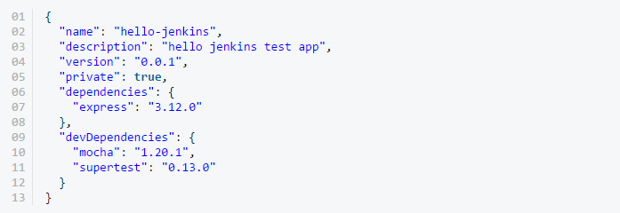
App Composition
package.json
Beijing Jiao Tong University

Slide 16
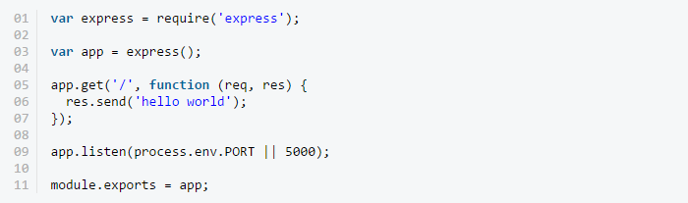
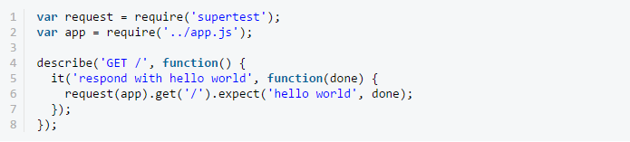
App and Test
app.js
test.js
Beijing Jiao Tong University

Slide 17

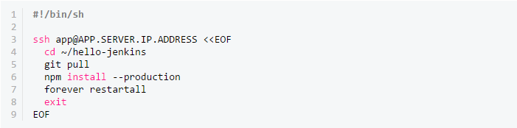
Utility to Trigger Test and Deploy automatically
script/test
script/deploy
Beijing Jiao Tong University

Slide 18
Jenkins tutorials
-- Solution
Beijing Jiao Tong University

Slide 19
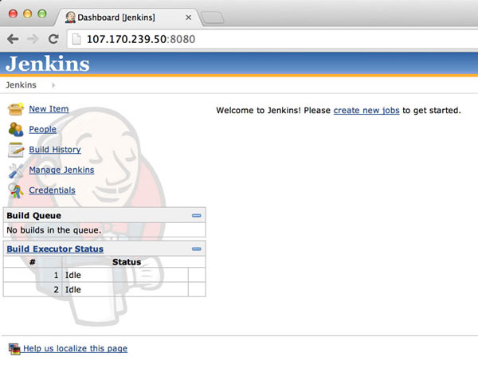
Installation - Hire the Butler
Beijing Jiao Tong University

Slide 20
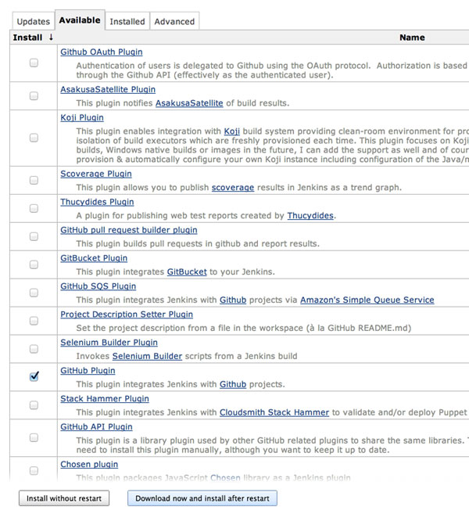
Manage Jenkins plugins
Manage Jenkins ->
Manage Plugins ->
Available ->
GitHub Plugin ->
Install ->
Download now and install after restart
Beijing Jiao Tong University

Slide 21
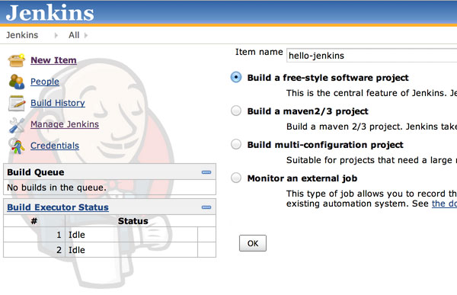
Build a free-style job
Beijing Jiao Tong University

Slide 22
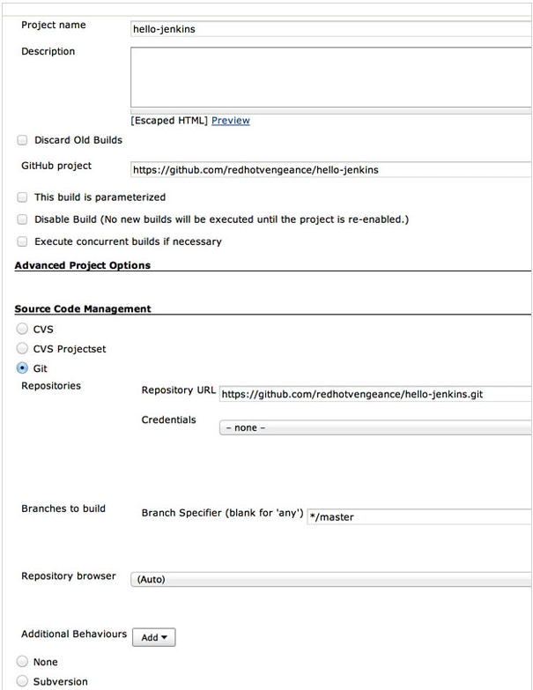
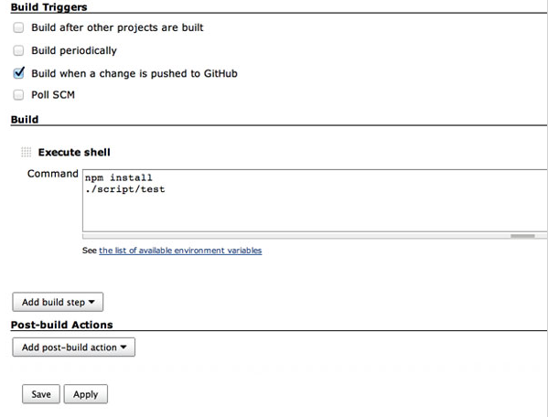
Config. the test job
Beijing Jiao Tong University

Slide 23
Generate ssh before config. the deploy job
Our script will login to the app server via SSH, navigate to our app folder, update the app, and then restart the server. Before writing our deploy script, we need to handle how our Jenkins server will SSH into our app server.
sudo su
su jenkins
ssh-keygen -t rsa (/var/lib/jenkins/.ssh/id_rsa, make sure to not use a passphrase)
cat ~/.ssh/id_rsa.pub
mkdir ~/.ssh
nano ~/.ssh/authorized_keys (paste the public key you copied and save)
chmod 700 ~/.ssh
chmod 600 ~/.ssh/*
ssh app@APP.SERVER.IP.ADDRESS
Beijing Jiao Tong University

Slide 24
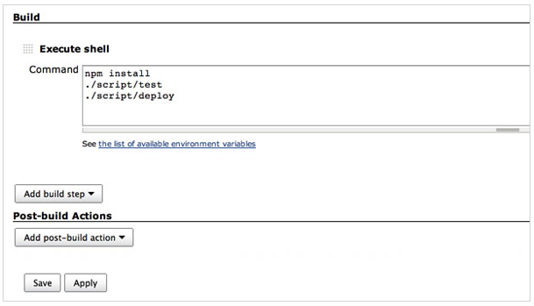
Config. the deploy job
Beijing Jiao Tong University

Slide 25
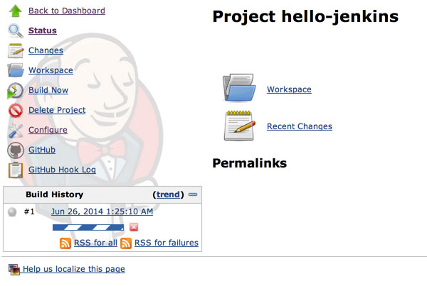
Monitor the jobs
Beijing Jiao Tong University

Slide 26
Master/Slave (Distributed)
A "master" operating by itself is the basic installation of Jenkins and in this configuration the master handles all tasks for your build system.
It will serve all HTTP requests, and it can still build projects on its own. Once you install a few slaves you might find yourself removing the executors on the master in order to free up master resources
Beijing Jiao Tong University

Slide 27
Have Master Launch Slave Agent via ssh
Jenkins has a built-in SSH client implementation that it can use to talk to remote sshd and start a slave agent.
Go to Jenkins master url on master machine:
-- Manage Jenkins->Manage Nodes->New Node->Config. (such as host, credential, executor, etc…)
Go to Jenkins master url on slave machine:
-- Manage Jenkins-> Manage Nodes->Launch
Refer to the detail steps
Beijing Jiao Tong University

Slide 28
Requirement for CI Setup
Hosted Production environment, Staging environment, etc
Master/Slave mode in Jenkins setup
-- Master is accessible via hosting service
Build job, Test job, Deploy job and Any other jobs in Jenkins
-- Project streaming by the way of ‘build->test->deploy’
-- All types of jobs can be running automatically
The task runner, Test runner and Test FWK
-- For web app and node server
Grunt to automate the repetitive tasks
karma to automate the launch of automation test
Mocha + Chai to develop test codes
-- For android app
Ant/Maven to automate the repetitive tasks
Instrumentation to automate the launch of automation test
JUnit + Assert to develop test codes
The Linux utilities
-- Use shell to automate the setup of development environment, such as Java config, Node config, IDE config, Proxy config, PATH config, etc..
Beijing Jiao Tong University

Slide 29
Reference
http://nvie.com/posts/a-successful-git-branching-model/
http://gitref.org/
http://en.wikipedia.org/wiki/Jenkins_(software)
http://jenkins-ci.org/category/tags/tutorial
http://code.tutsplus.com/tutorials/setting-up-continuous-integration-continuous-deployment-with-jenkins--cms-21511
https://wiki.jenkins-ci.org/display/JENKINS/Step+by+step+guide+to+set+up+master+and+slave+machines
https://wiki.jenkins-ci.org/display/JENKINS/Distributed+builds
Beijing Jiao Tong University

